Slide 1

LMS
LearnX
Online Learning Platform
Name: Sonali Genan Tandel
M.Sc. Computer Application Part – 1
Roll No.: 19
Seat No: 120

Slide 2
LMS
INTRODUCTION
LearnX is a Learning Management System (LMS) designed to make teaching and learning easier and more interactive.
It connects Admins, Instructors, and Students on a single platform.
Provides features like course creation, lessons, exams, results, and progress tracking.
Aims to enhance accessibility, engagement, and efficiency in the learning process.

Slide 3
LMS
OBJECTIVE
Provide a centralized platform for managing courses, lessons, and exams.
Enhance student learning through easy access, progress tracking, and results.
Support instructors and admins with efficient tools for teaching and management.
Promote interactive and engaging learning experiences using digital resources.

Slide 4


LMS
MODULES &
FEATURES
Let's begin.

Slide 5
ADMIN MODULE
Manage users (add, update, delete Admins, Instructors, and Students).
Approve / reject courses submitted by instructors.
Maintain system security and data integrity.
Generate and view reports on courses, categories, exams, and user
activity
Monitor revenue reports (total earnings, instructor payouts, commissions).
Oversee the overall functioning of the LMS.

Slide 6
INSTRUCTOR MODULE
Manage account (view, update)
Add new courses with titles, descriptions, and categories.
Upload lessons with content, videos, and resources.
Create, schedule, and manage exams for students.
Track student performance and generate exam reports (results).
Edit course and lesson materials anytime.

Slide 7
STUDENT MODULE
Manage account (view, update)
Enroll in courses and access lessons, videos, and resources.
Attempt exams online.
Track personal progress and view results instantly.
Engage in an interactive and user-friendly learning environment.
Download certificates after course completion.

Slide 8
LMS
USED TECHNOLOGY
Frontend:
React.js – For building dynamic and responsive user interfaces.
HTML, CSS, JavaScript – Core web technologies for structure and styling.
Backend:
Node.js – Server-side runtime environment.
Express.js – Web framework for building APIs and handling requests.
Database:
MongoDB – NoSQL database to store users, courses, lessons, and results.
Other Tools & Libraries:
Multer – For file uploads (videos, images, documents).
JWT – For authentication and session management.
Postman – For testing APIs.

Slide 9
LMS
HARDWARE REQUIREMENT
Processor: Intel i3 / i5 or equivalent
RAM: 4 GB (Client), 8 GB (Server)
Storage: 100 GB (Client), 256 GB SSD (Server)
Internet: Stable high-speed connection

Slide 10


LMS
DATA FLOW DIAGRAM
Let's begin.

Slide 11
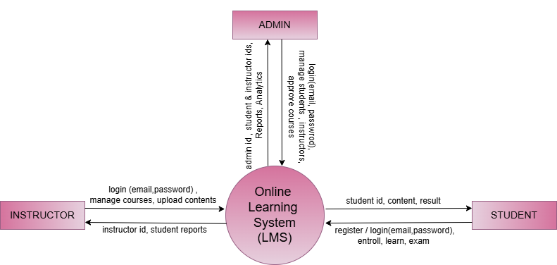
0 (Context) Level

Slide 12
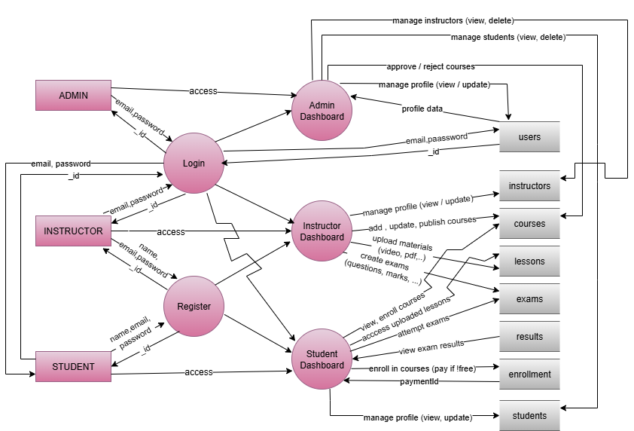
1st Level

Slide 13
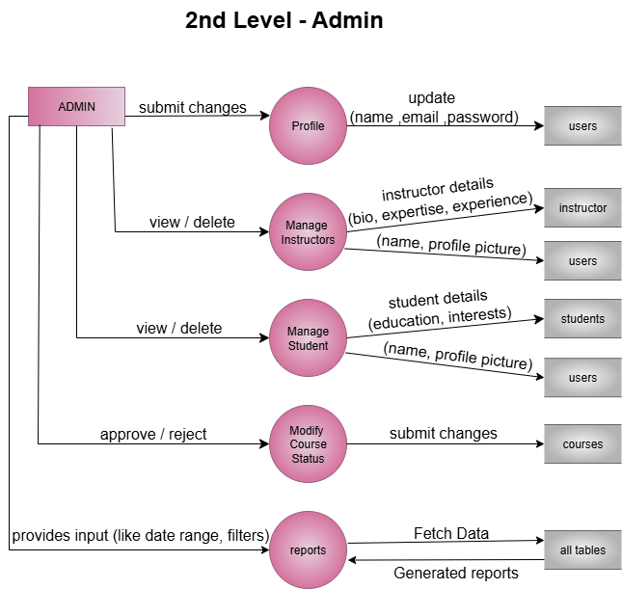
2nd Level (Admin)

Slide 14
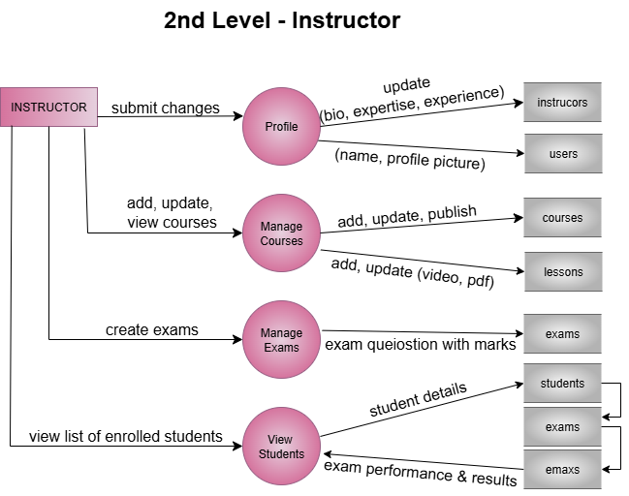
2nd Level (Instructor)

Slide 15
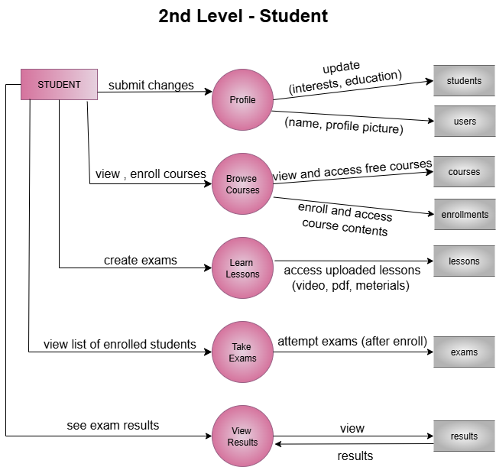
2nd Level (Student)

Slide 16
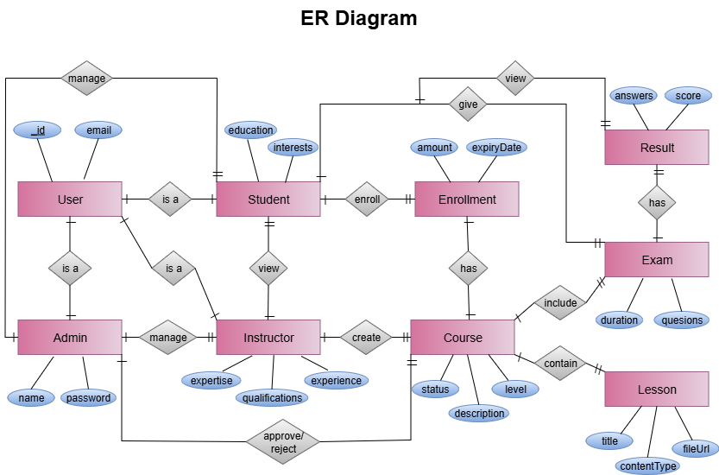
E-R Diagram

Slide 17
LMS
DATABASE DESIGN
(TABLES)
Let's begin.

Slide 18
users
Field | Type | Key | Default
_id | String | Primary | -
name | String | - | -
email | String | Unique | -
password | String | - | -
role | String (enum: admin, instructor, student) | - | -
profilePic | String | - | /upload/default.png

Slide 19
instructors
Field | Type | Key | Default
_id | String | Primary | -
user | String | Ref: user | -
bio | String | - | -
expertise | [String] | - | -
qualifications | [String] | - | -
experience | number | - | -
courseCreated | String | Ref: course | -

Slide 20
students
Field | Type | Key | Default
_id | String | Primary | -
user | String | Ref: user | -
education | String | - | -
interests | [String] | - | -
enrolledCourses | String | Ref: course | -

Slide 21
categories
Field | Type | Key | Default
_id | String | Primary | -
name | String | - | -
Status | String (enum: approved, pending, rejected) | - | approved
suggestedBy | String | Ref: user | -
createdAt | Date | - | Date.now

Slide 22
courses
Field | Type | Key | Default
_id | String | Primary | -
title | String | - | -
description | String | - | -
level | String | - | -
category | String | Ref: category | -
instructor | String | Ref: user | -
lesson | String | Ref: lesson | -
exams | String | Ref: exam | -
price | Number | - | 0
thumbnail | String | - | -
status | String (enum: draft, pendingApproval, approved, rejected) | - | draft

Slide 23
enrollments
Field | Type | Key | Default
_id | String | Primary | -
student | String | Ref: user | -
course | String | Ref: course | -
amount | Number | - | -
paymentId | String | - | -
orderId | String | - | -
paymentStatus | String (enum: pending, complete, failed) | - | Pending
paymentDate | Date | - | Date.now
status | String (enum: active,completed, cancelled) | - | Active
expiryDate | Date | - | After 6 months
progress | Number | - | 0 , Min: 0, Max: 100
completedLessons | String | Ref: lesson | -
examProgress: examId attempts bestScore lastAttemptAt isCompleted | String Number Number Date Boolean | Ref: exam - - - - | - 0, Max: 3 0 - False
certificate: | String | - | null

Slide 24
lessons
Field | Type | Key | Default
_id | String | Primary | -
course | String | Ref: course | -
title | String | - | -
contentType | String (enum: video, pdf, text) | - | -
fileUrl | String | - | -
description | String | - | -
isPreviewFree | Boolean | - | False

Slide 25
exams
Field | Type | Key | Default
_id | String | Primary | -
course | String | Ref: course | -
title | String | - | -
duration | Number | - | -
questions: questionText options correctAnswer marks | String [String] String Number | - - - - | - - - 1

Slide 26
results
Field | Type | Key | Default
_id | String | Primary | -
exam | String | Ref: exam | -
student | String | Ref: user | -
answers questionId selectedOption | String String | - - | -
Score | Number | - | 0
attemptNumber | Number | - | 1

Slide 27
payments
Field | Type | Key | Default
_id | String | Primary | -
student | String | Ref: user | -
instructor | String | Ref: user | -
course | String | Ref: course | -
amount | String | - | -
platformCommission | Number | - | 30 (%)
instructorEarning | number | - | -
status | String (enum: pending, completed, failed) | - | completed
paymentId | String |  | -
paymentDate | Date | - | Date.now
paymentMethod | String (enum: Razorpay, PayPal, Bank Transfer) |  | Razorpay

Slide 28
contactus
Field | Type | Key | Default
_id | String | Primary | -
name | String | - | -
email | String | - | -
subject | String | - | -
Message | String | - | -
status | String (enum: pending, resolved) | - | Pending

Slide 29
LMS
PAGE SCREENTSHORTS
Let's begin.

Slide 30
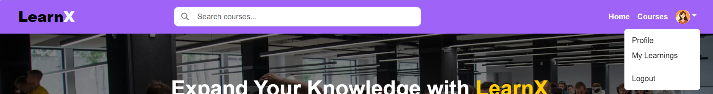
Navbar
Before Login
After Login

Slide 31

Home Page

Slide 33
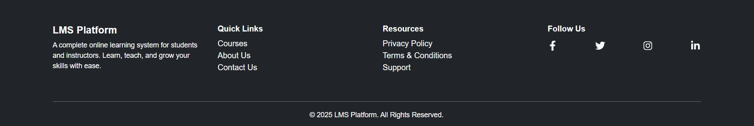
Footer

Slide 34
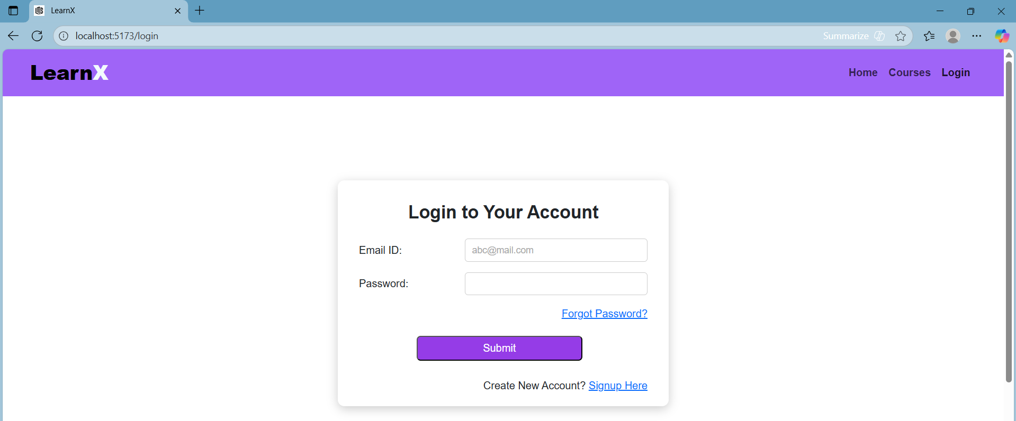
Login Page

Slide 35
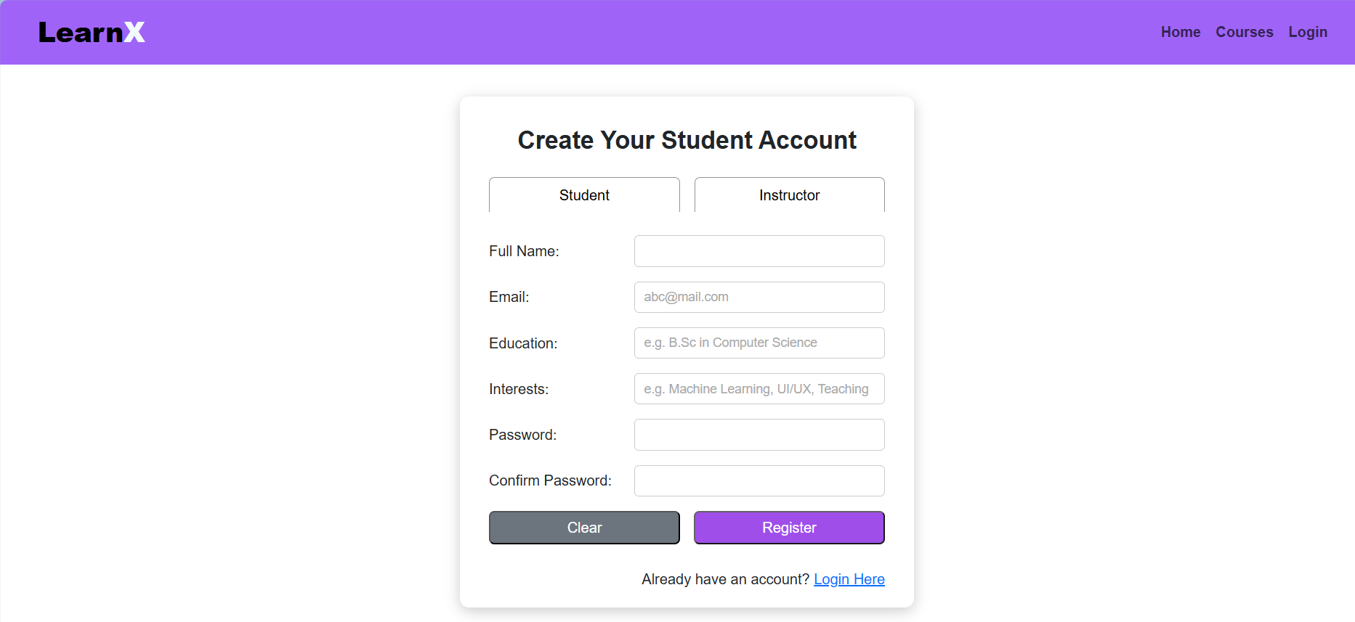
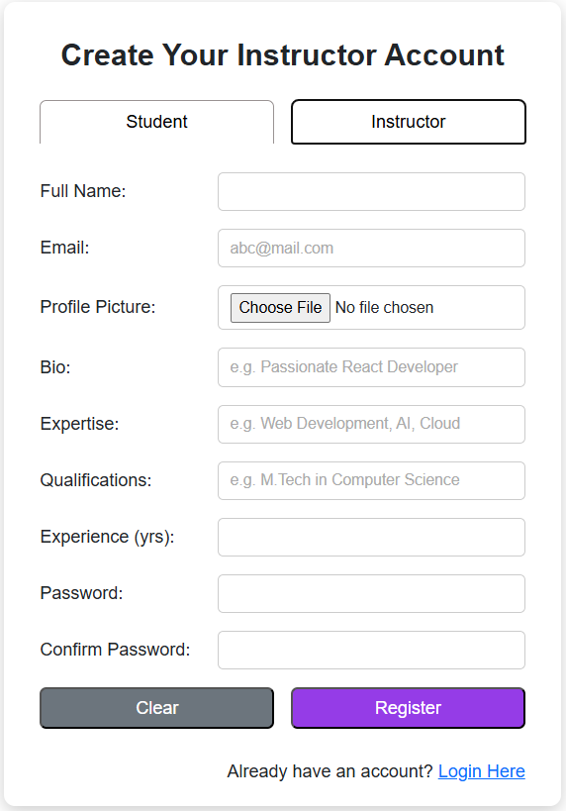
Register Page

Slide 36
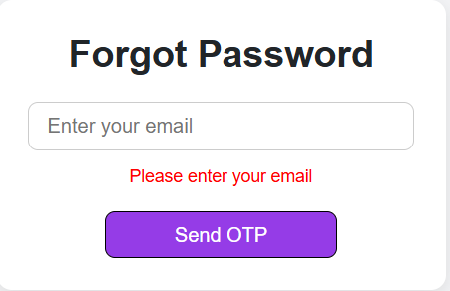
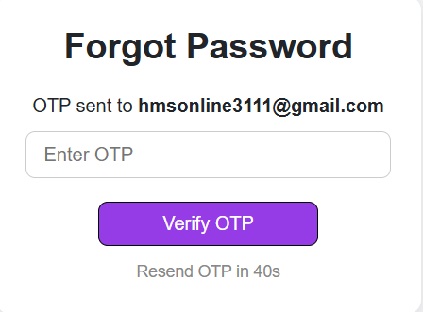
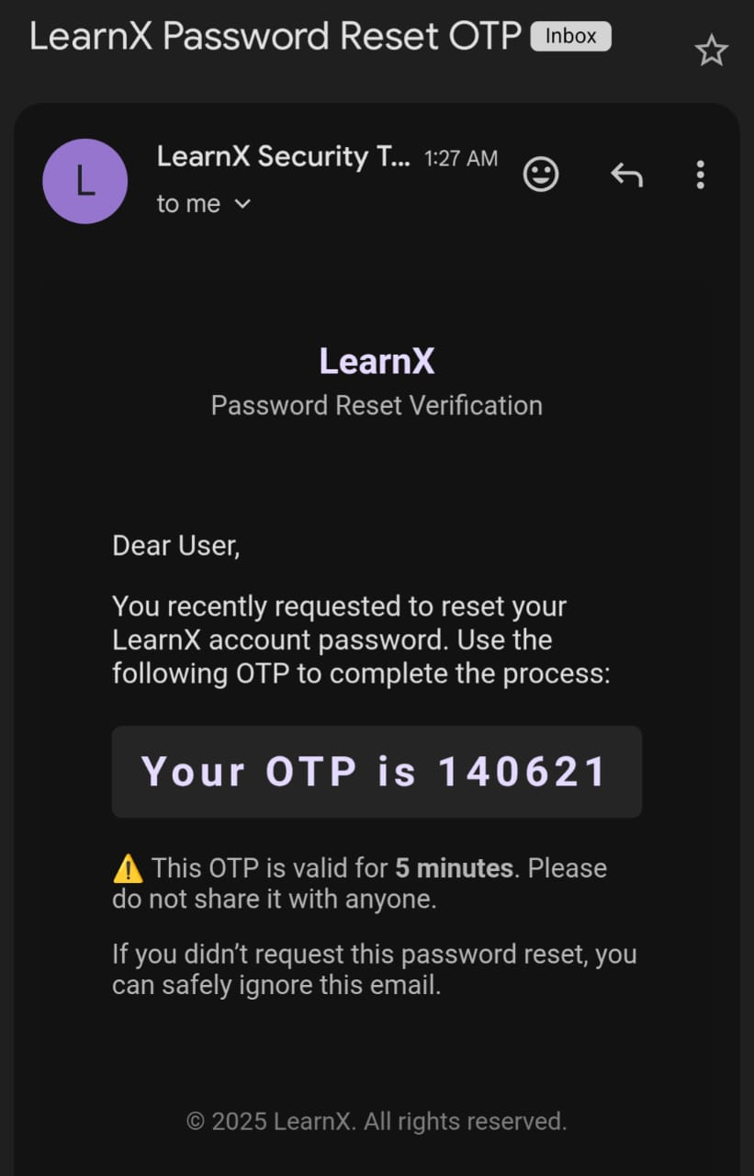
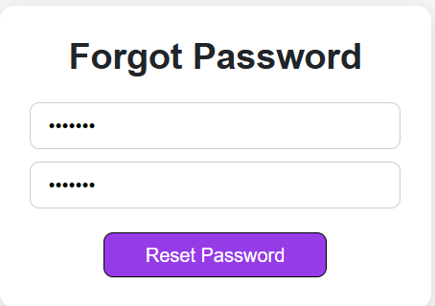
Forgot Password Page

Slide 37
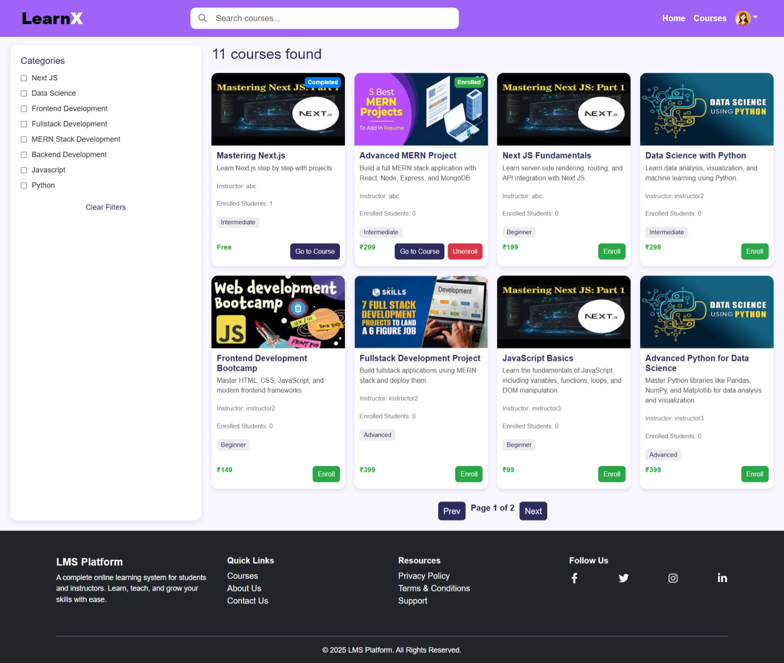
Courses Page

Slide 38
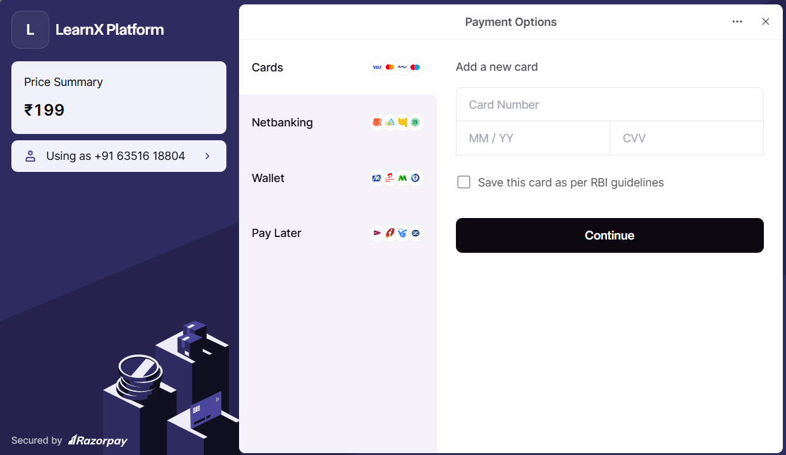
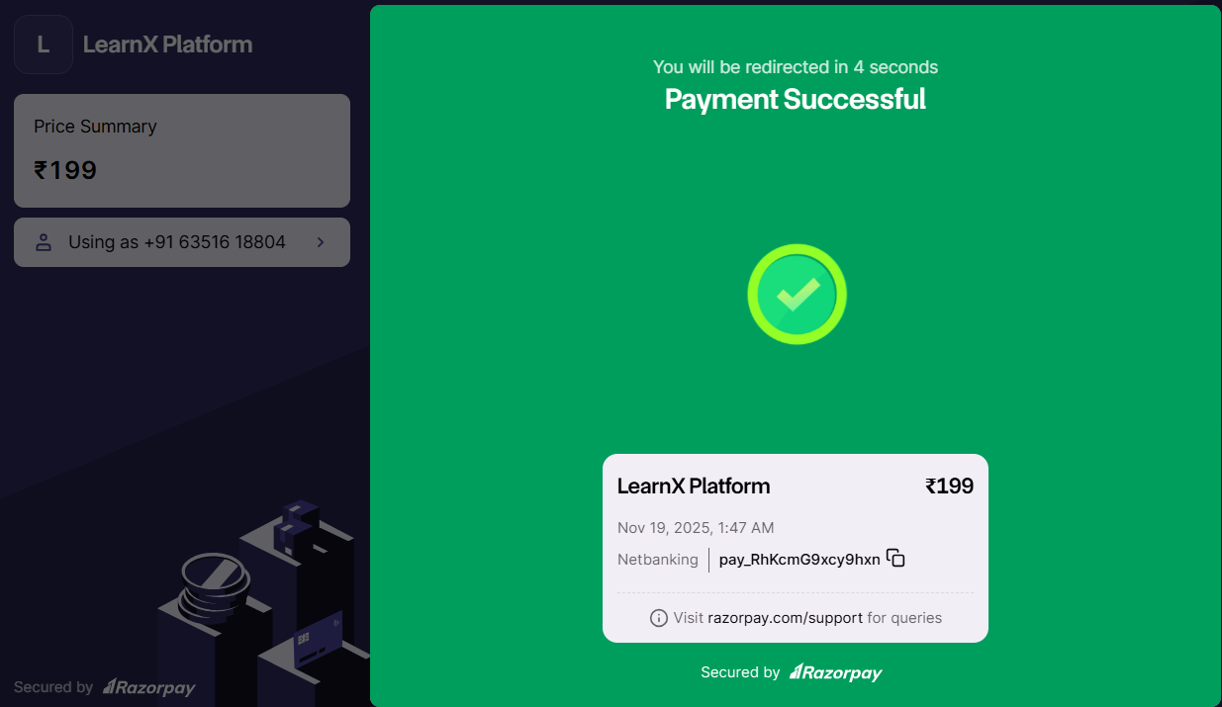
Courses Page
Enrollment process

Slide 39
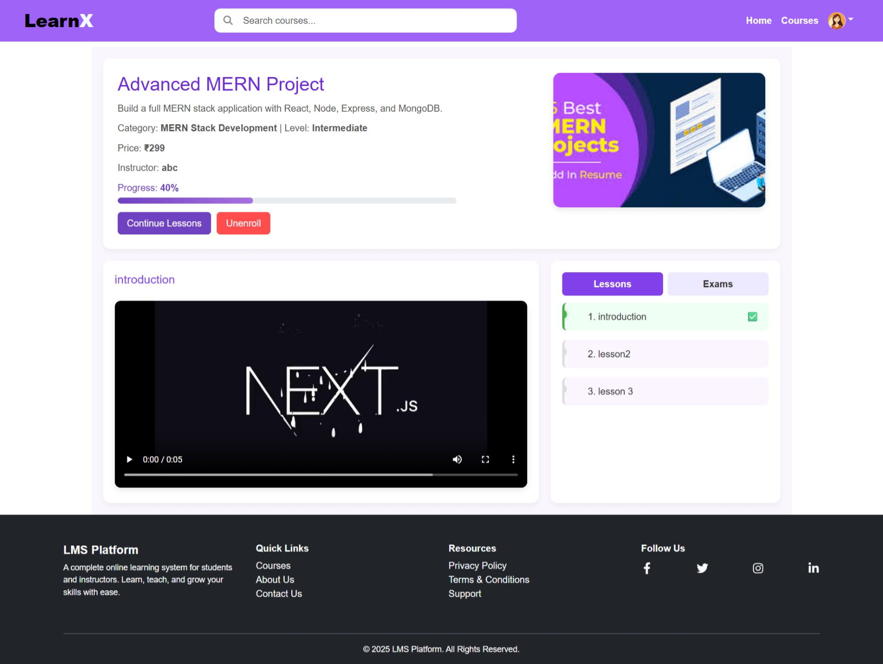
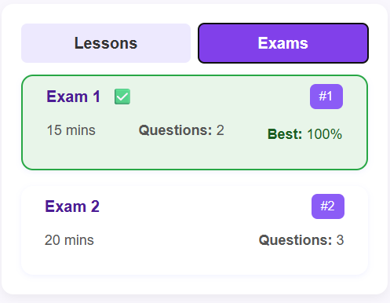
Course Detail Page

Slide 40
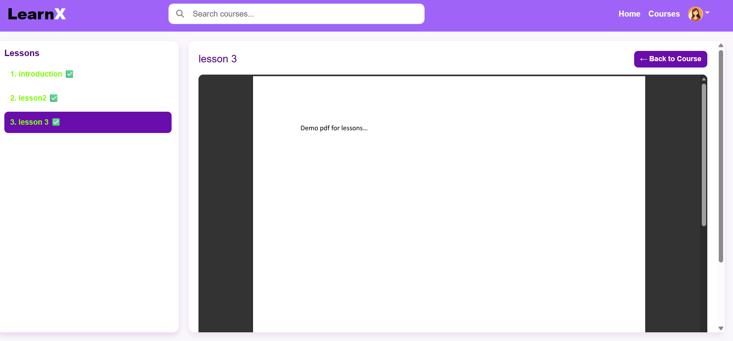
Lessons Page

Slide 41
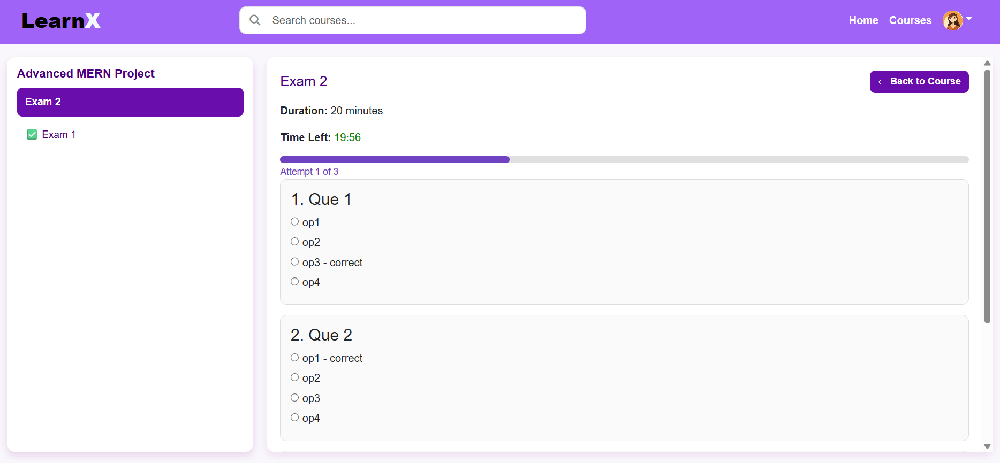
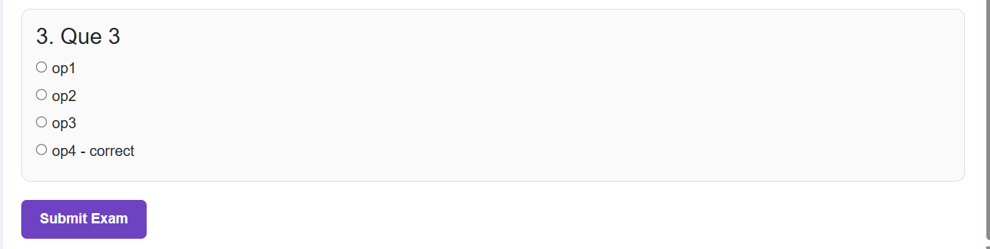
Exams Page

Slide 42
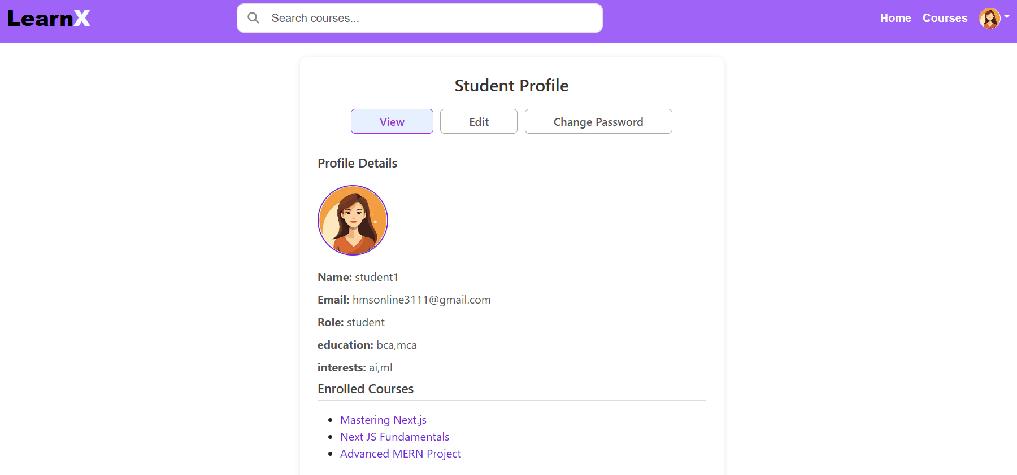
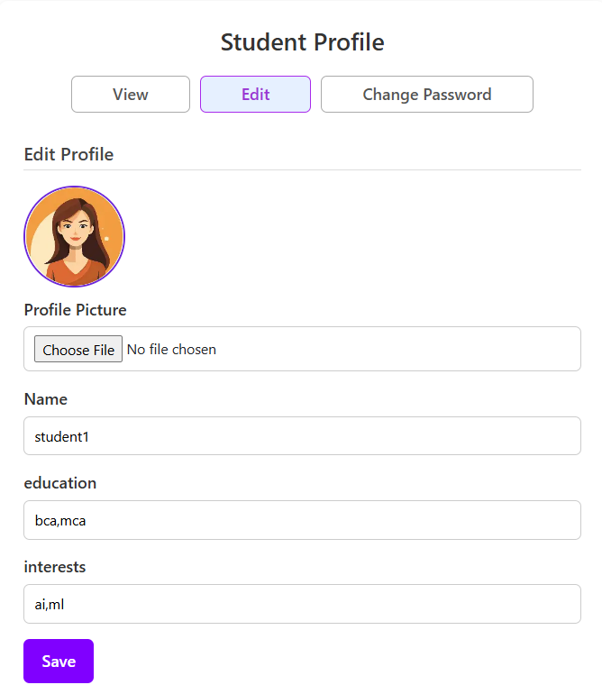
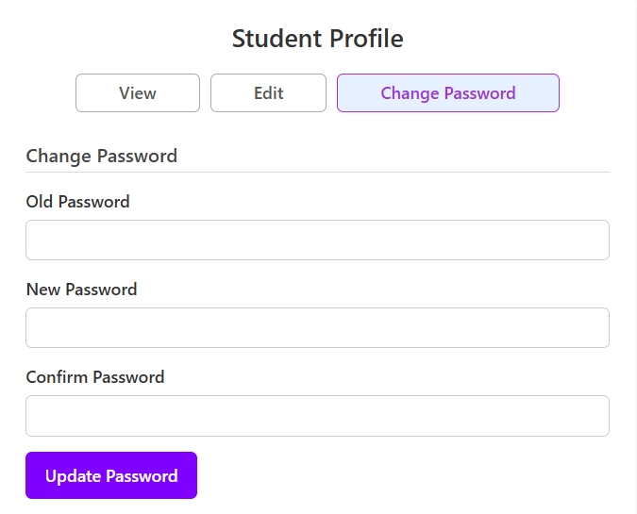
Profile Page

Slide 43
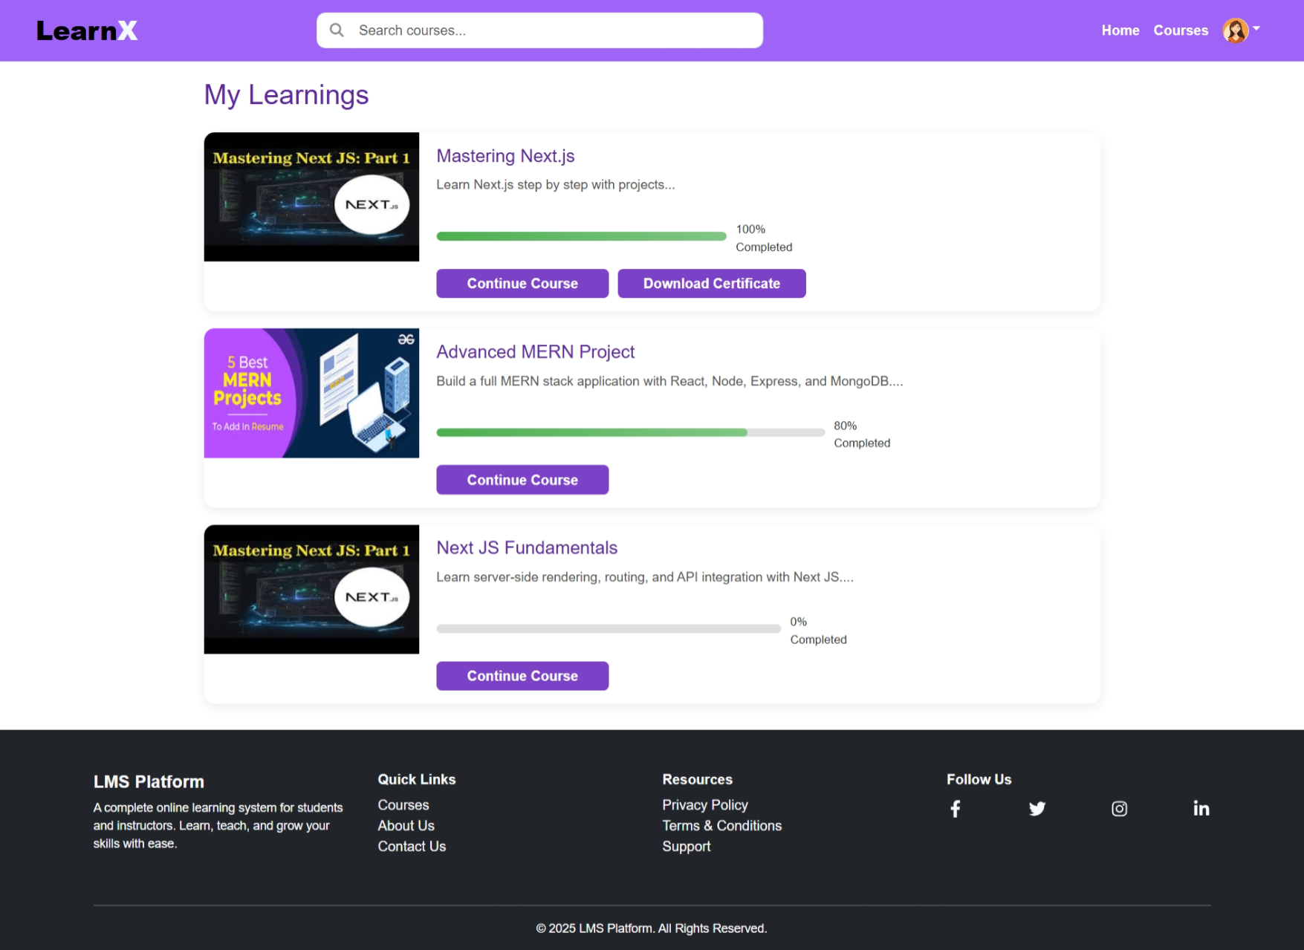
Student Learning Page

Slide 44
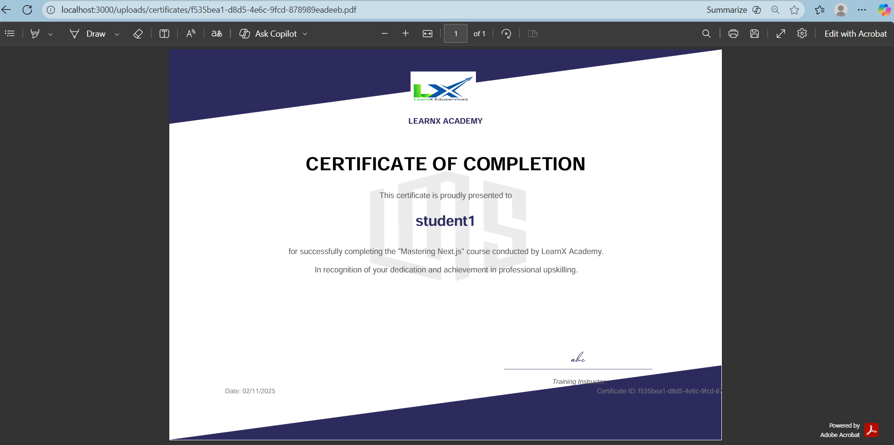
Complete Code Page

Slide 45
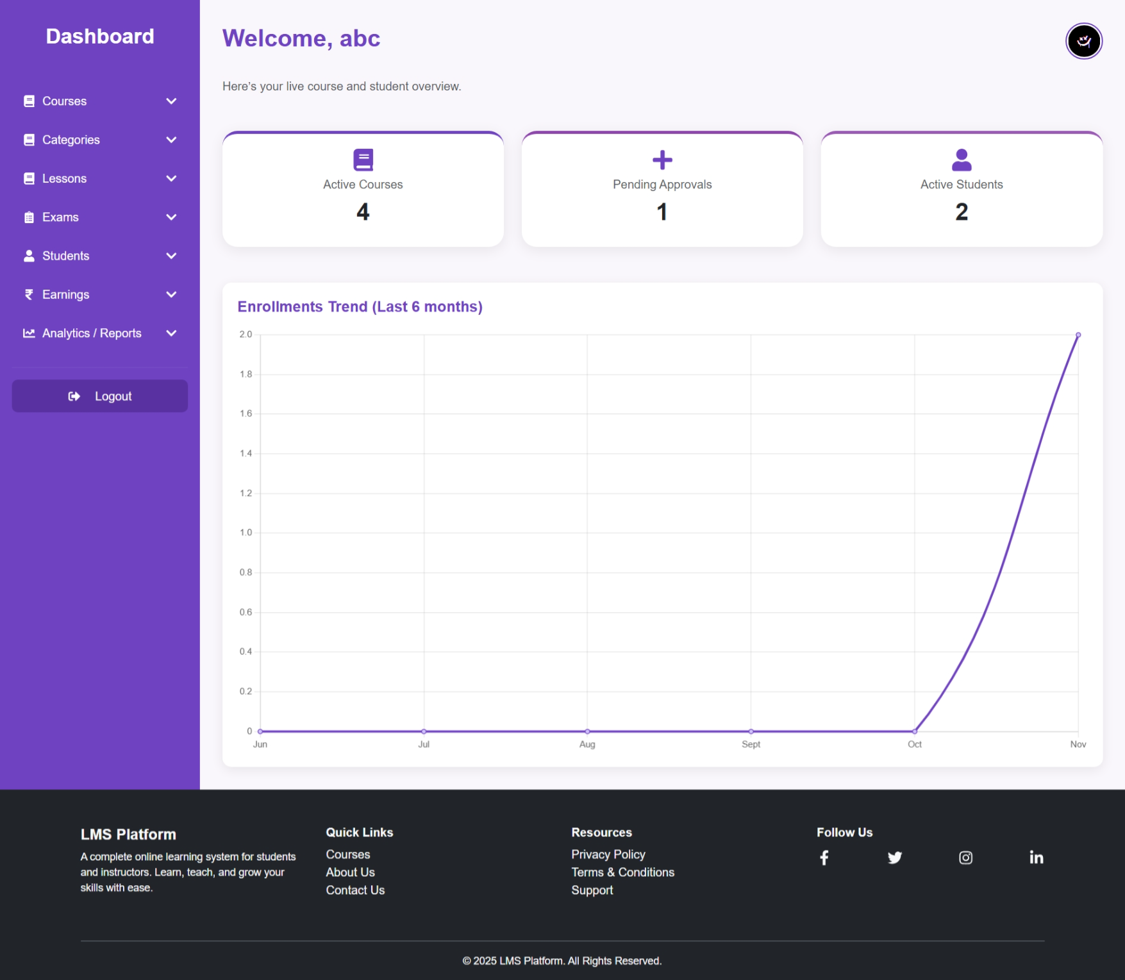
After Register / Login
Instructor Dashboard

Slide 46
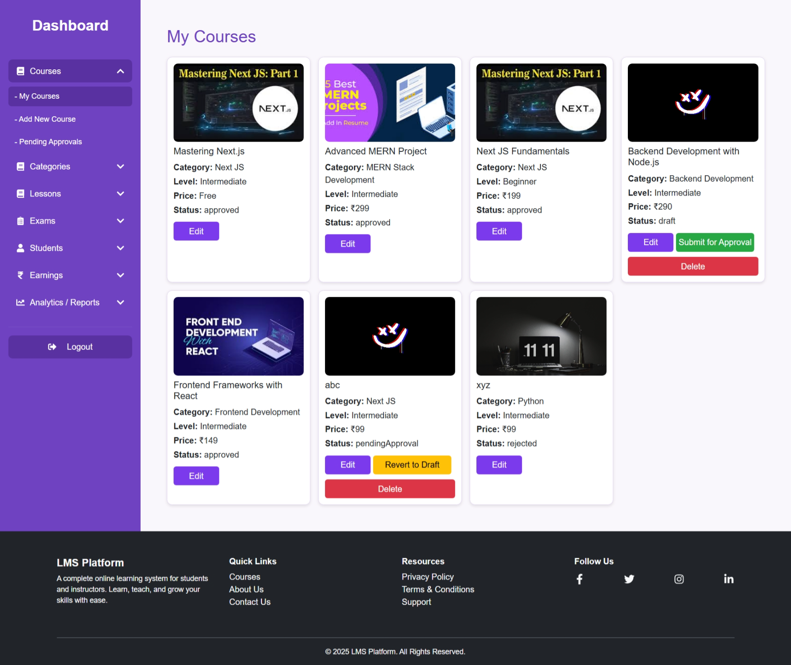
Manage Course Page

Slide 47
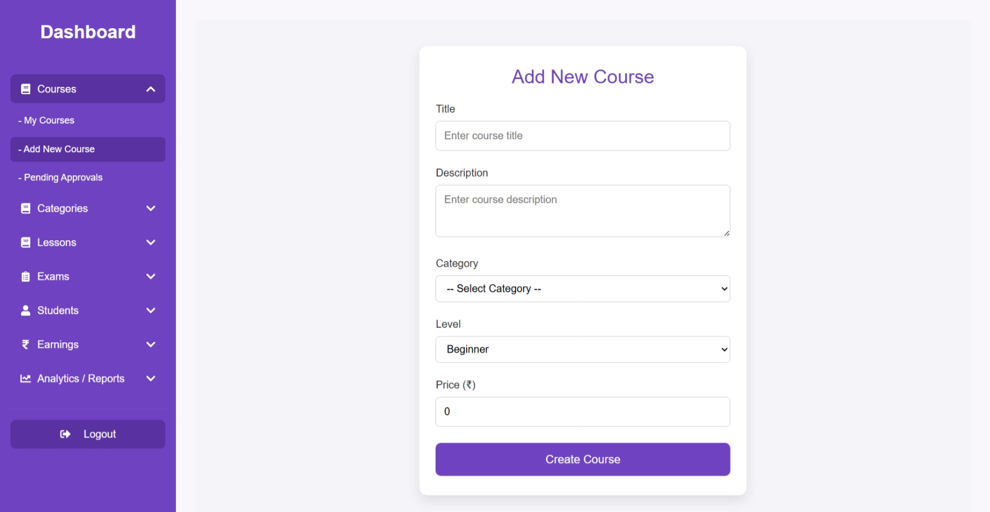
Add Course Page

Slide 48
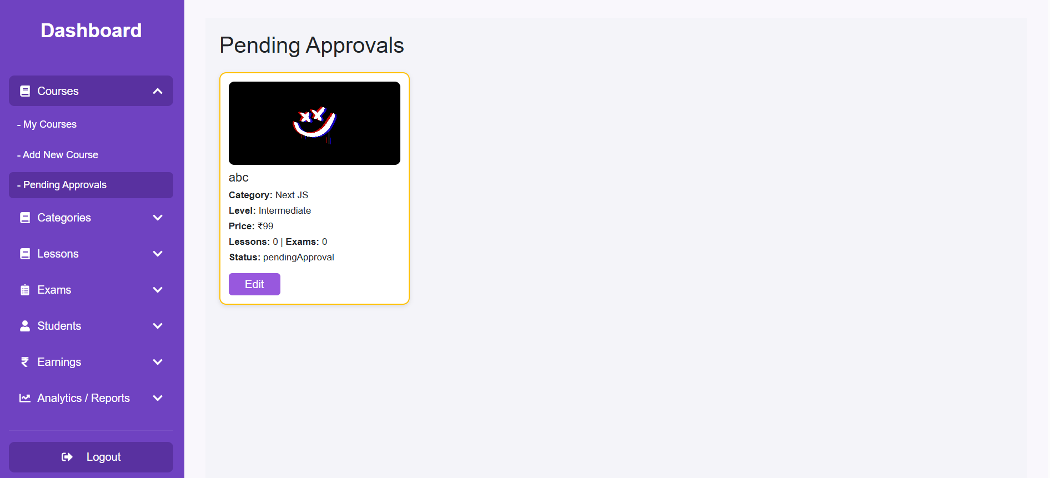
Pending Course Approval Page

Slide 49
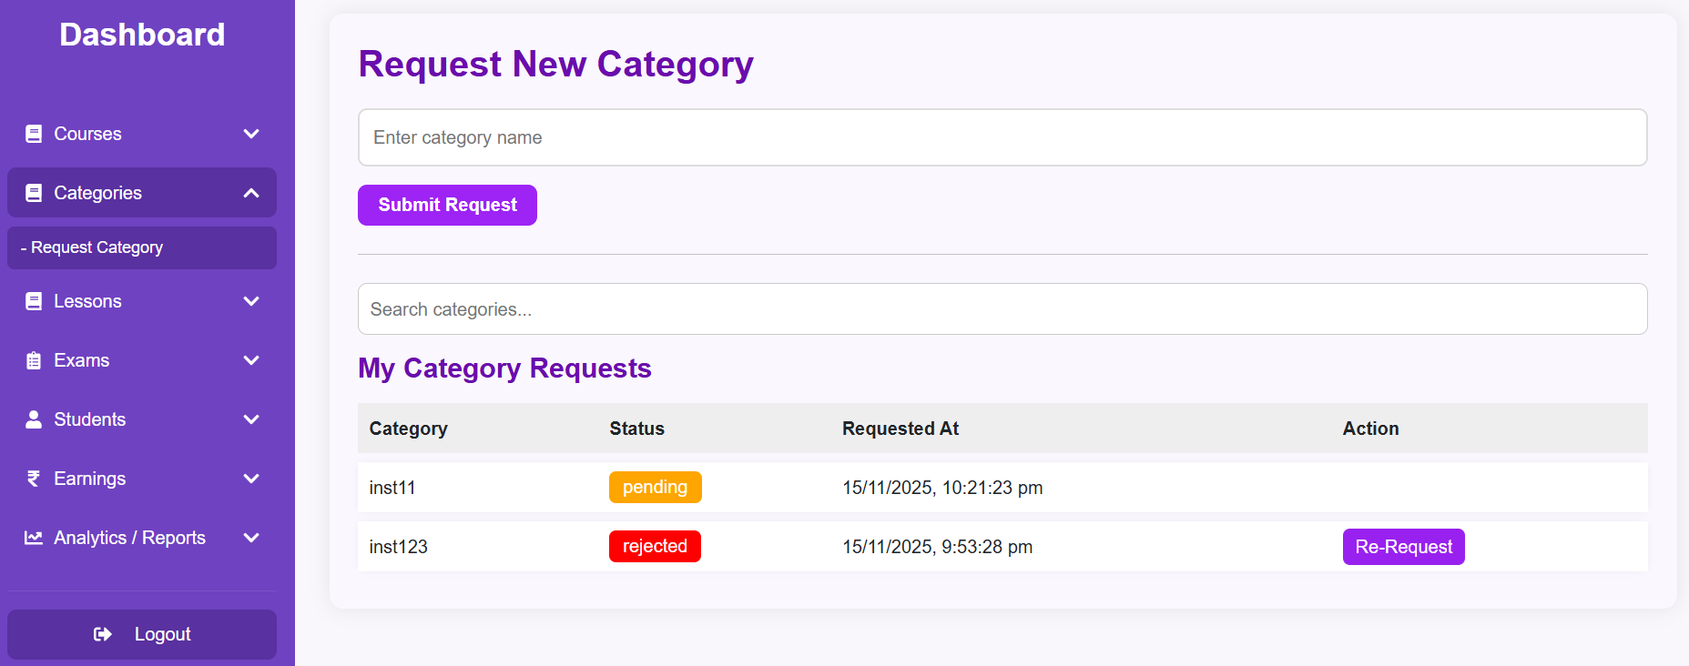
Request Category Page

Slide 50
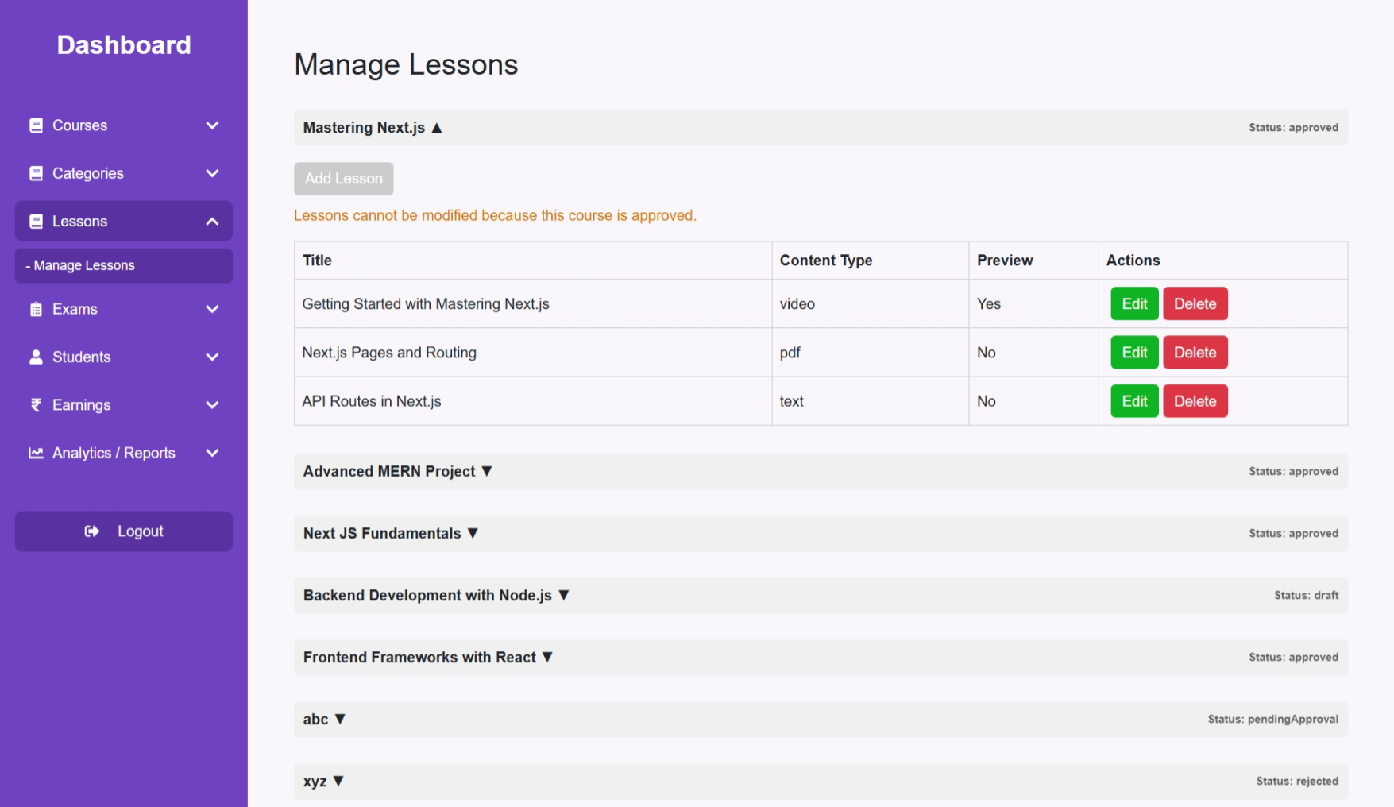
Manage Lessons Page

Slide 51
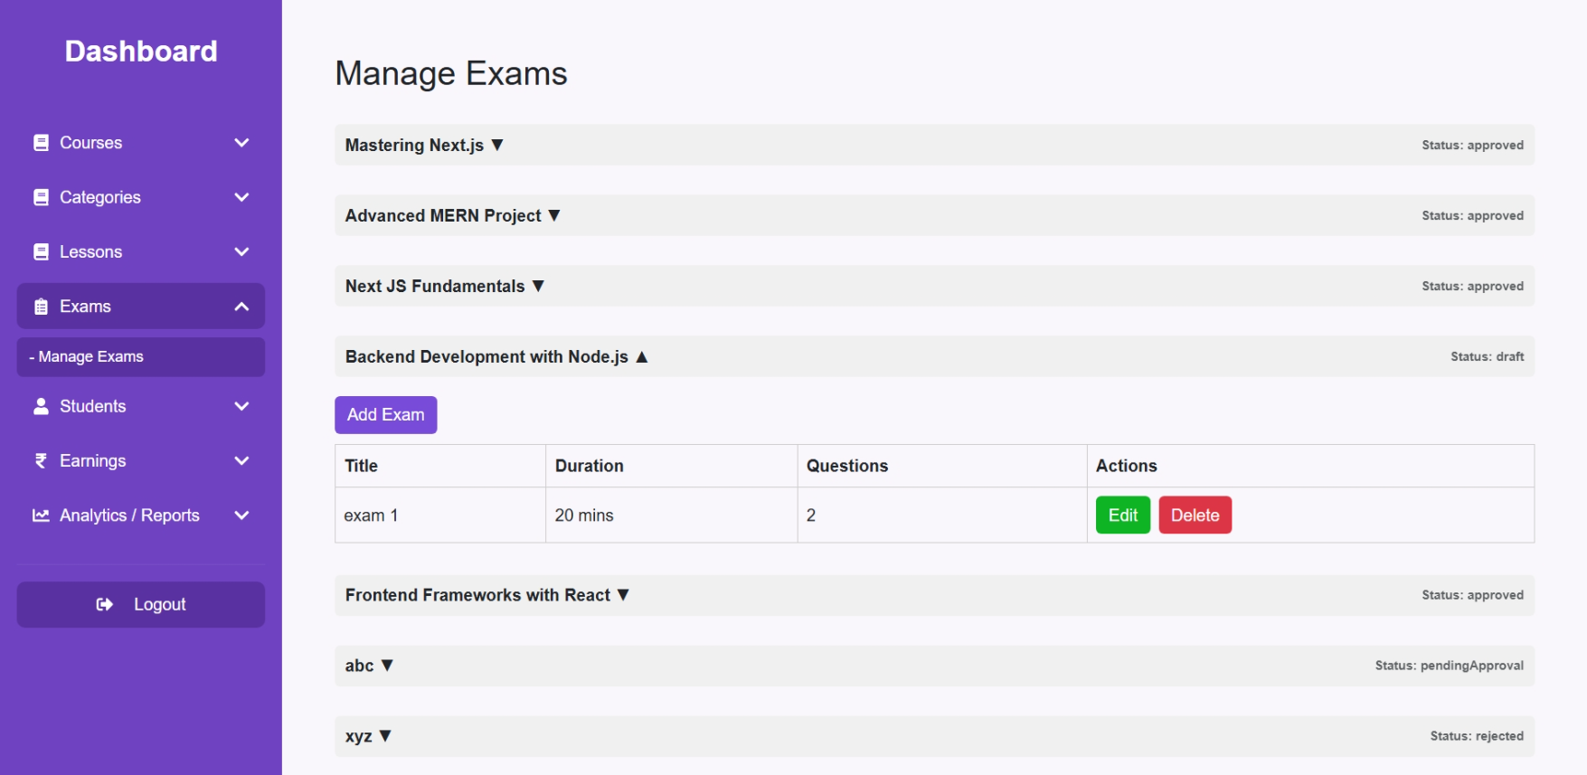
Manage Exams Page

Slide 52
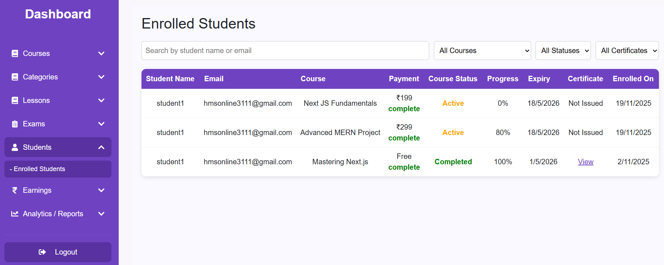
Enrolled Students Page

Slide 53
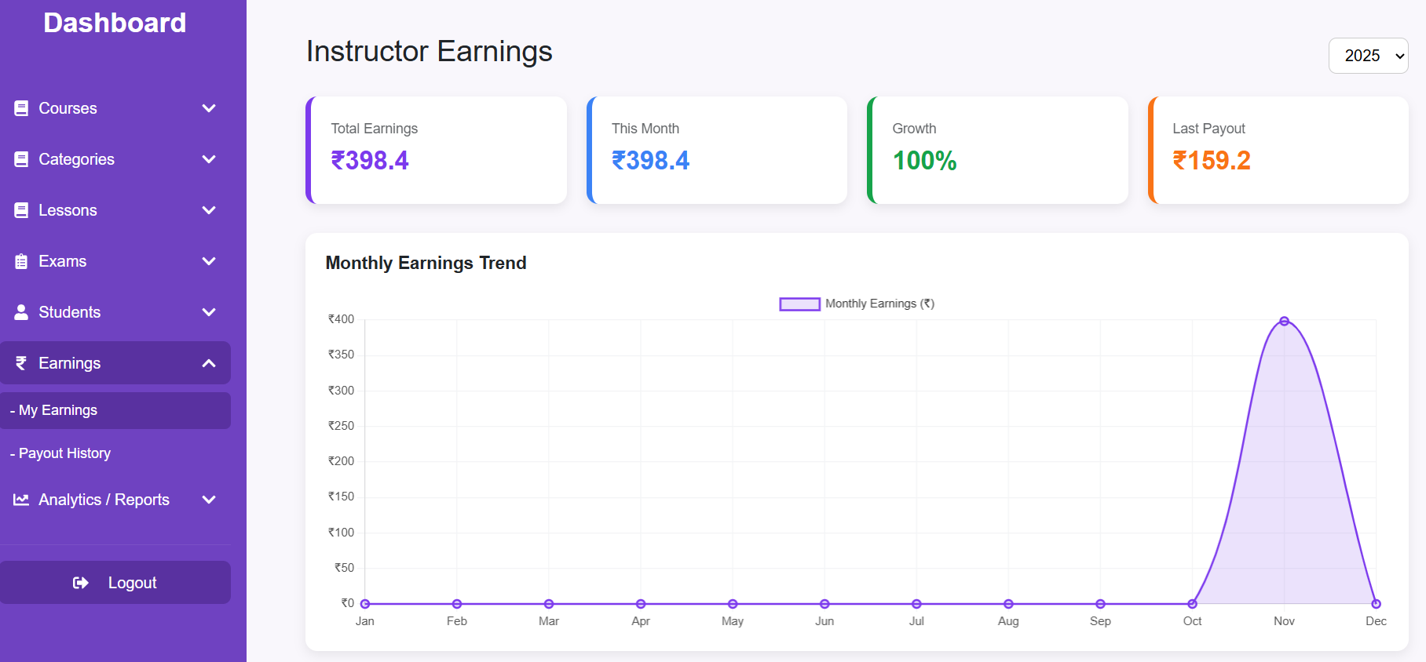
Instructor Earnings Page

Slide 54
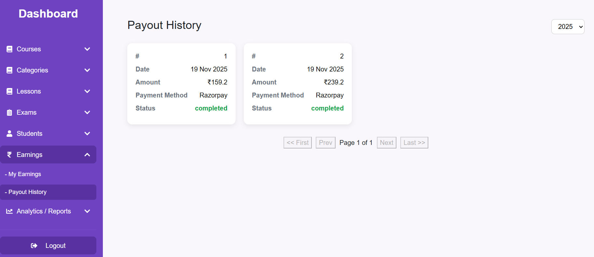
Payout History Page

Slide 55
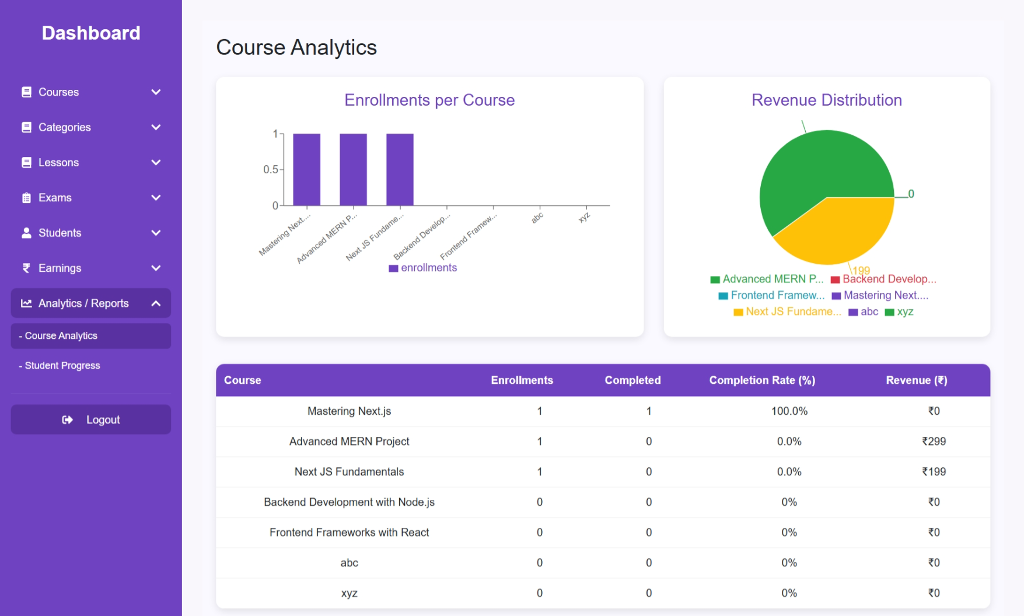
Course Analysis Page

Slide 56
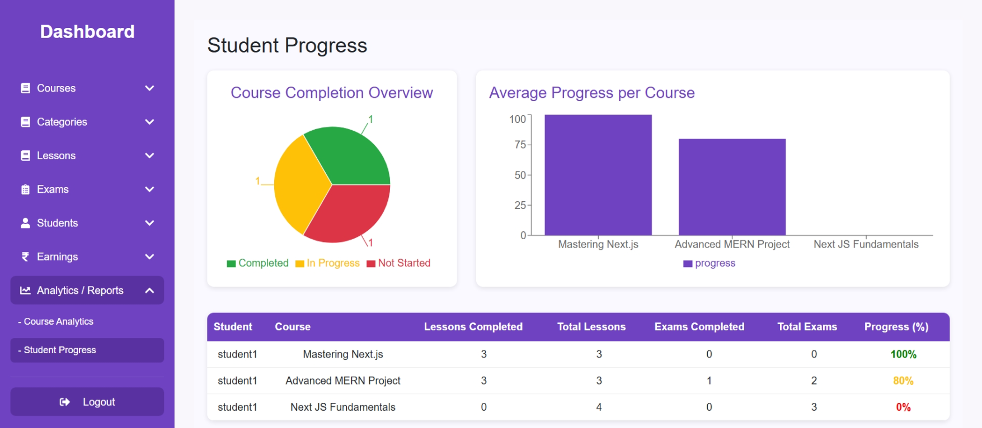
Student Progress Page

Slide 57
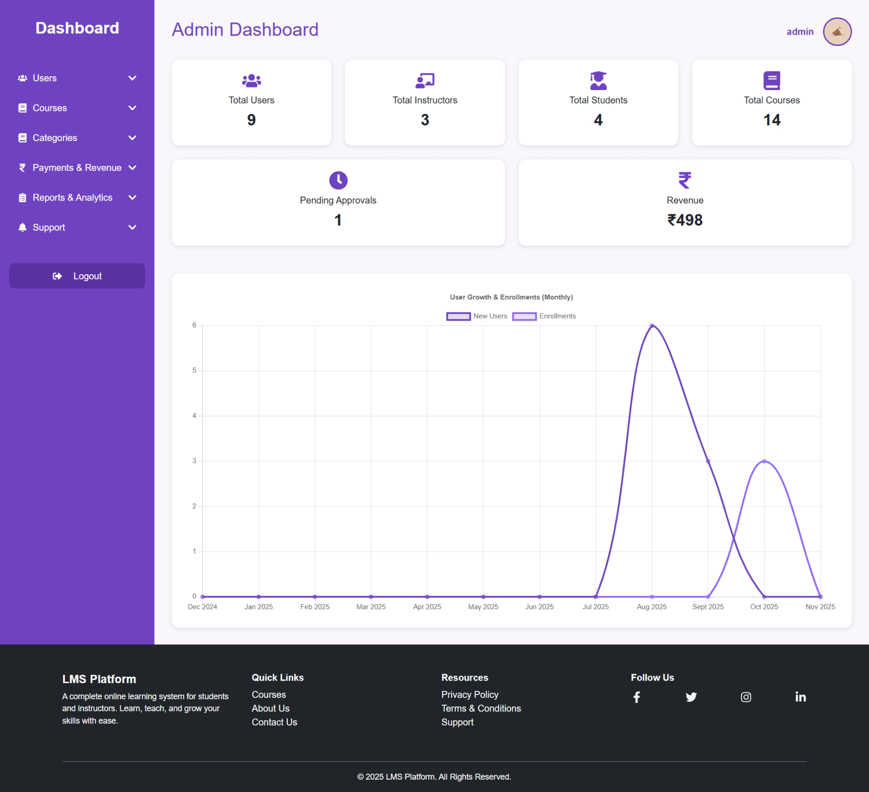
After Register / Login
Admin Dashboard

Slide 58
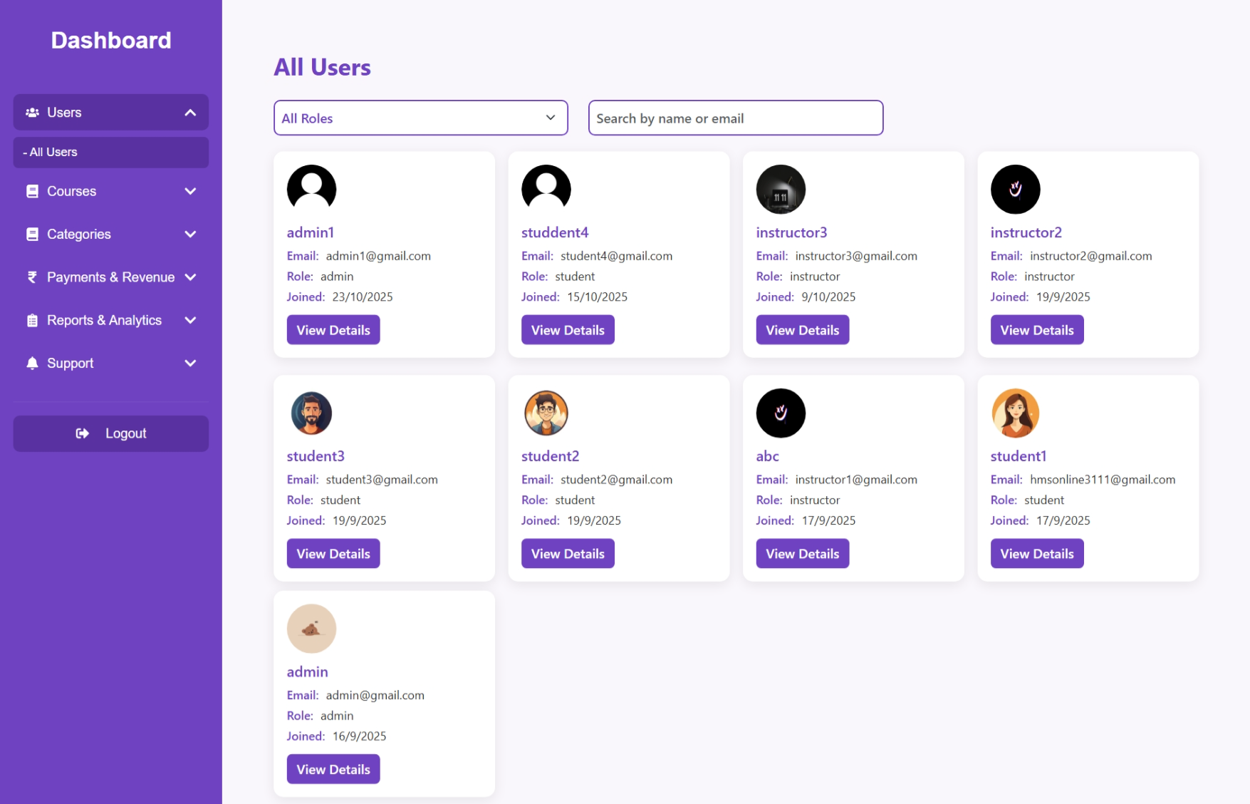
All Users Page

Slide 59
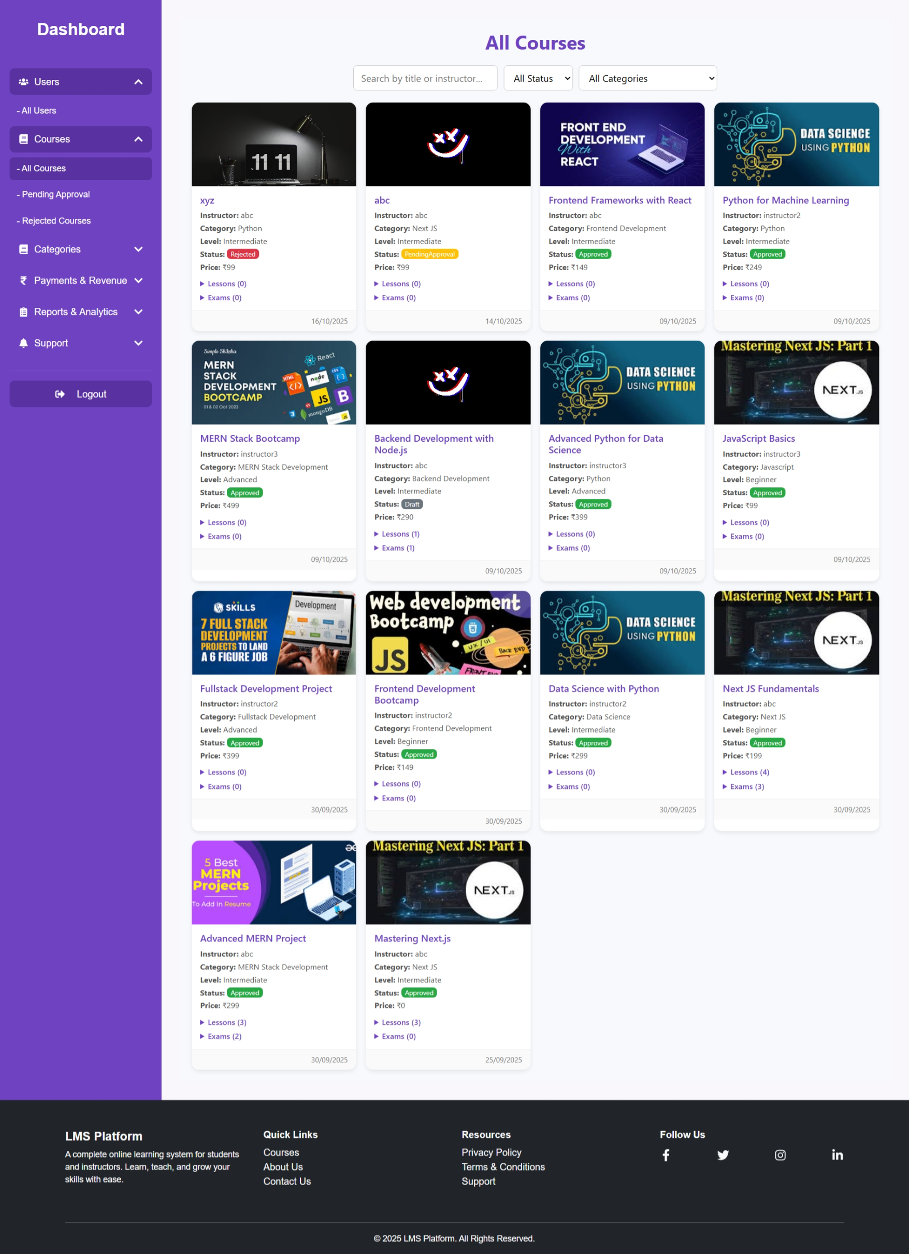
All Course Page

Slide 60
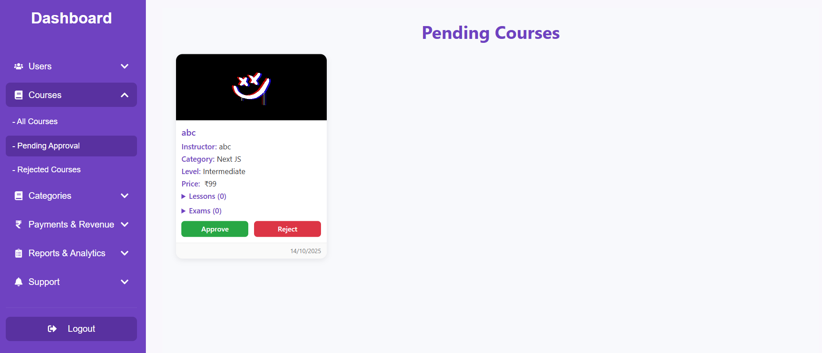
Pending Course Page

Slide 61
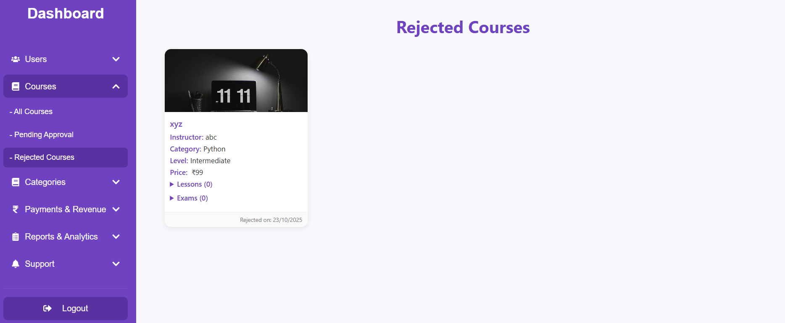
Rejected Course Page

Slide 62
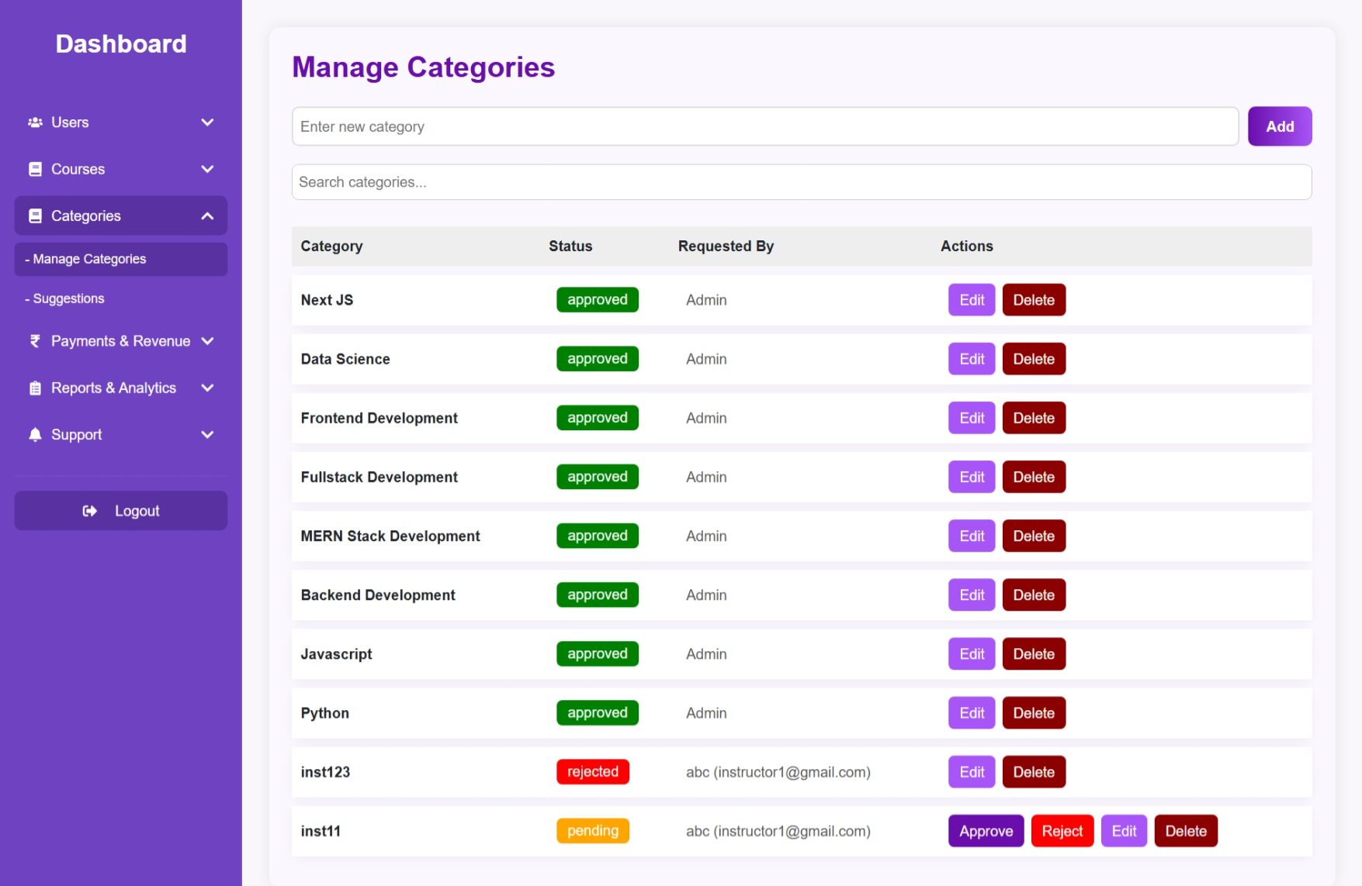
Manage Categories Page

Slide 63
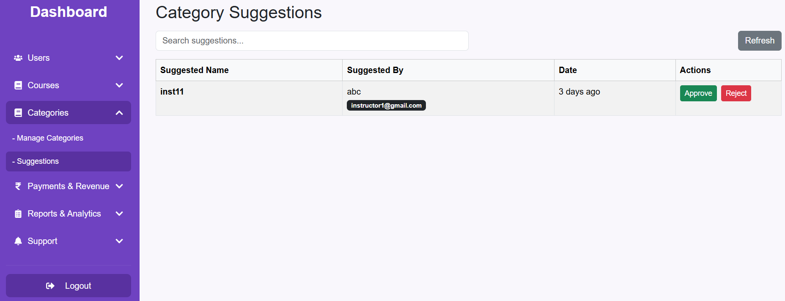
Category Suggestion Page

Slide 64
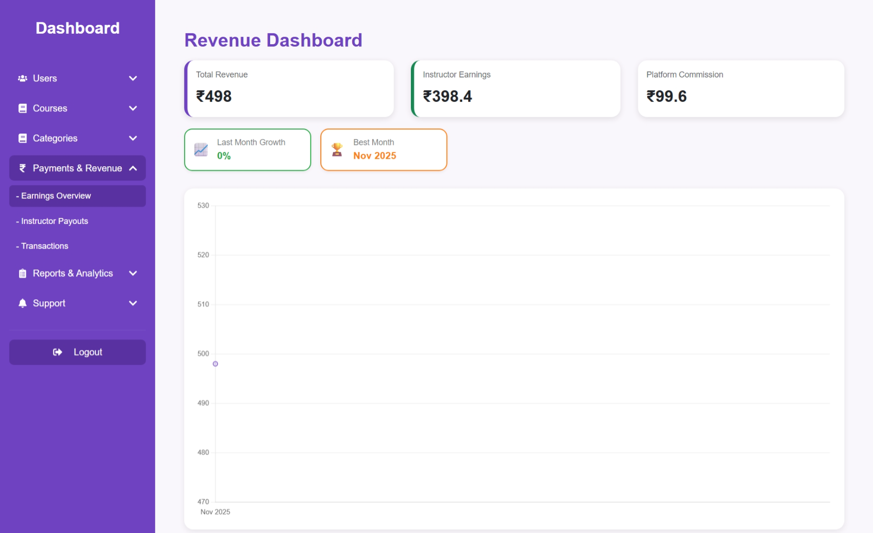
Revenue Page

Slide 65
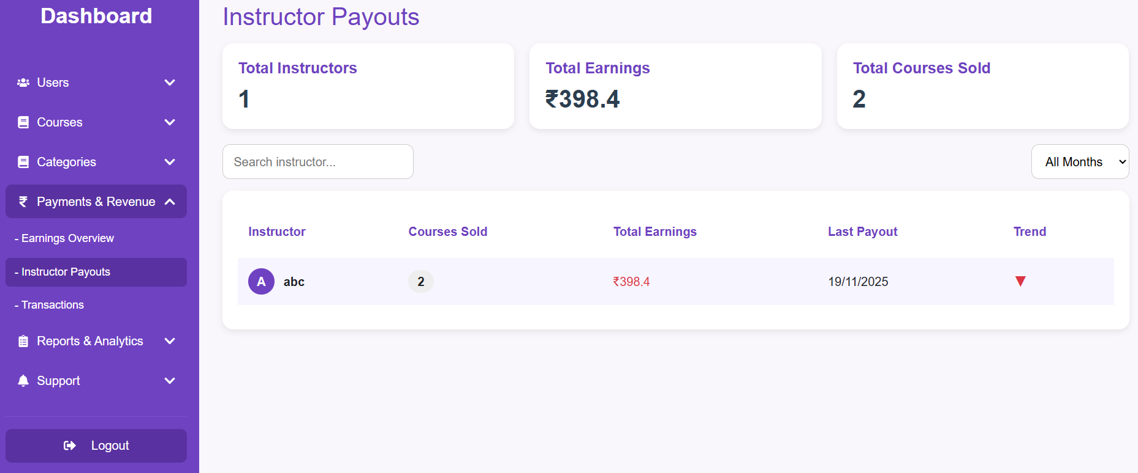
Instructor Payout Page

Slide 66
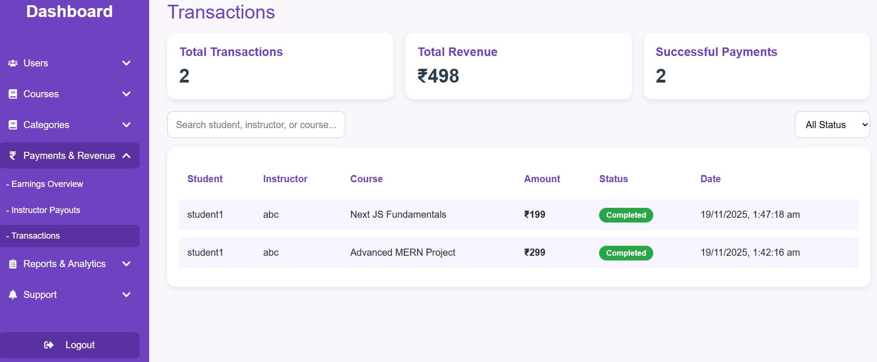
Transactions Page

Slide 67

Enrollment Stats Page

Slide 68

Course Performance Page

Slide 69

Contact Page

Slide 70

About Us Page

Slide 71

Contact Us Page

Slide 72

Privacy Policy Page

Slide 73

Terms & Conditions Page

Slide 74

Support Page

Slide 75
LMS
SUMMARY
LearnX empowers students to learn, instructors to teach, and admins to manage—all in one seamless platform.
Built with MERN stack, it delivers a personalized and interactive learning experience.

Slide 76
LMS
THANK YOU FOR YOUR TIME AND ATTENTION!
That’s a Wrap

